Slide 1



Presenting
In Depth SEO Audit
for
https://www.injectionqueen.nl/

Slide 2
Overall Site Observation

Slide 3
Chapter-1 – Semrush Stats

Slide 4
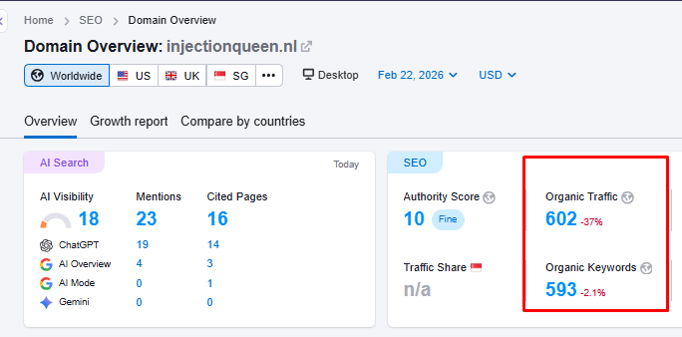
Chapter One
Overall Site Stats | Semrush
Observations
Organic traffic is very less and decline
Very less Keyword in Rankings as indicated by the second graph and decline

Slide 5
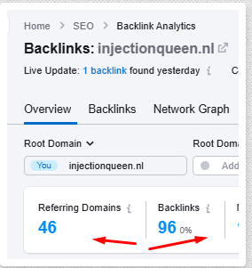
Chapter One
Backlink | Semrush
Observations
Backlink: 96, also decrease
Reffering Domain: 46, also decrease

Slide 6
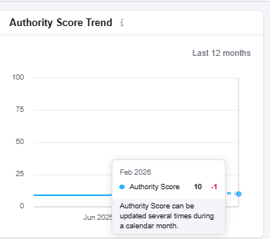
Chapter One
Authority Score | Semrush
Observations
Authority score is currently low

Slide 7
Chapter-2 – Technical SEO Stats

Slide 8
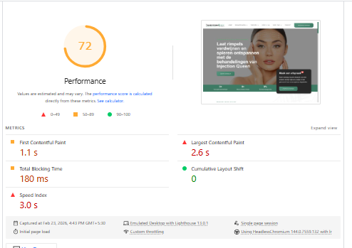
Chapter Two
Technical SEO Stats| Page Performance(Lighthouse) | Desktop
Current Observation
The Desktop Web Performance is poor .
Action Needed
Need to optimize the website to improve the core web vital metrics and improve UX score.

Slide 9
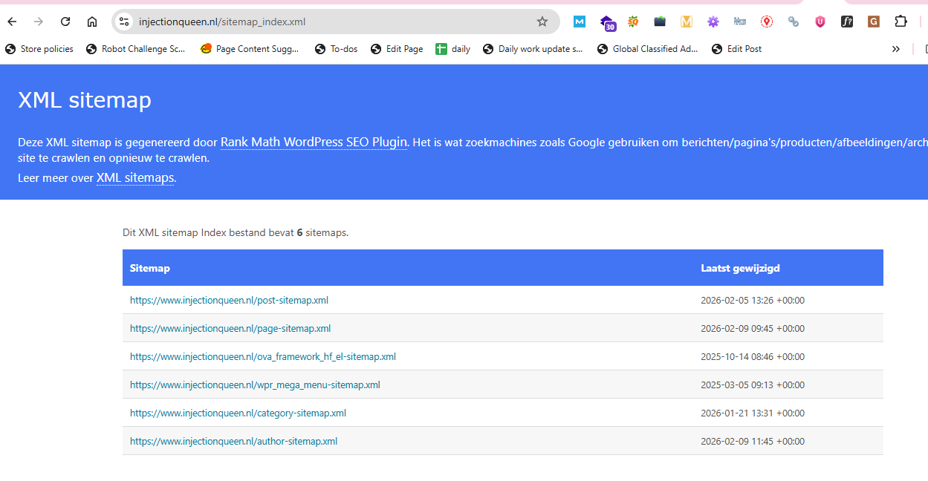
Chapter Two
Other On Page Issues| Sitemap
Current Observation
SITEMAP is present , need to update
Recommendation
Need to fix the on page elements
to make the site SEO-friendly.

Slide 10
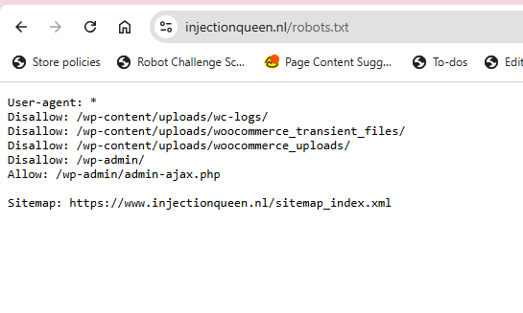
Chapter Two
Other On Page Issues| Robots.txt
Current Observation
Robots.txt file present on the site but need to add more advance directives

Slide 11
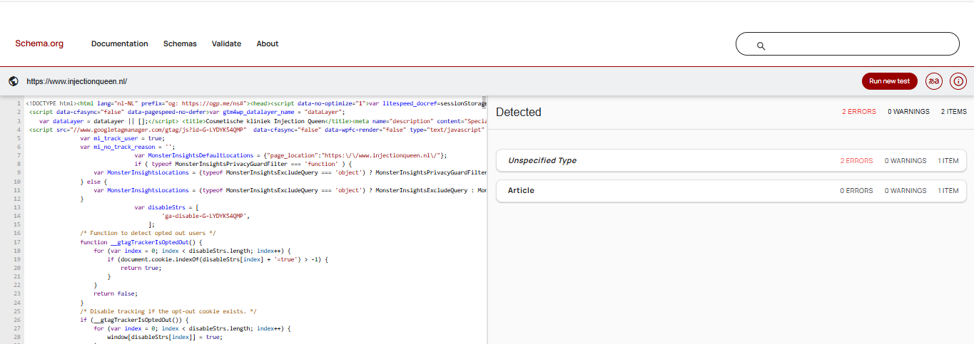
Chapter Two
Other On Page Issues| Structure Data
Current Observation
Schemas, is present , but need to update
Recommendation
Need to fix the on page elements
to make the site SEO-friendly.

Slide 12
Chapter 3 – Mobile Usability

Slide 13

Chapter Three
Mobile Usability | Responsiveness
Current Observation
The website is responsive

Slide 14
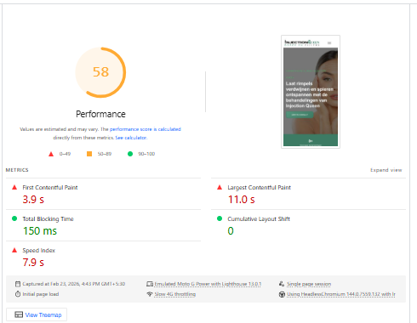
Chapter Three
Technical SEO Stats| Page Performance(Lighthouse) | Mobile
Current Observation
The Mobile Web Performance is poor.
Action Needed
Need to optimize the website to improve the core web vital metrics and improve UX score.

Slide 15
Chapter 4– On Page SEO Stats

Slide 16
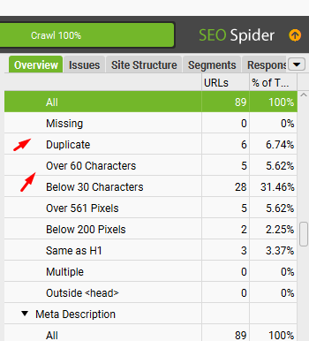
Chapter Four
Onpage SEO Stats| Screaming Frog |Title
Current Observation
Duplicate: 6
Below 30 Characters: 28
Recommendation
Need to fix the on-page elements
to make the site SEO-friendly.

Slide 17
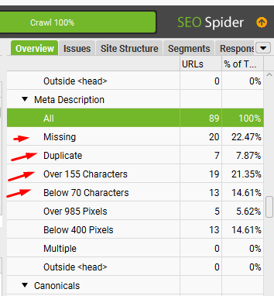
Chapter Four
Onpage SEO Stats| Screaming Frog |Description
Current Observation
Missing: 20
Duplicate: 7
Over 155 Characters: 19
Below 70 Characters: 13
Recommendation
Need to fix the on-page elements
to make the site SEO-friendly.

Slide 18
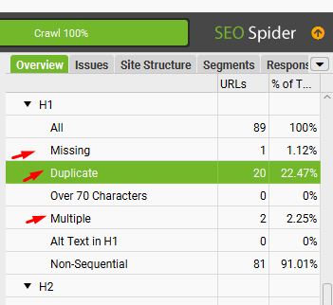
Chapter Four
Onpage SEO Stats| Screaming Frog |H1
Current Observation
Missing: 1
Duplicate: 20
Multiple: 2
Recommendation
Need to fix the on-page elements
to make the site SEO-friendly.

Slide 19
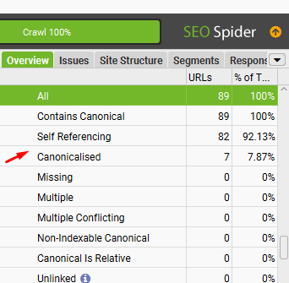
Chapter Four
Onpage SEO Stats| Screaming Frog |Canonicals
Current Observation
Canonicalised: 7
Recommendation
Need to fix the on-page elements
to make the site SEO-friendly.

Slide 20
Chapter Four
On Page SEO Final Verdict
Current Observation
The Website has deep structural and integral issues in Development. Also there is complete lack of any Keyword Mapping strategy in developing the Website.
This explains the loss in Keyword Rankings and Organic Traffic.
Recommendation
Develop a Keyword Targeting Strategy and Mapping.
Develop a Content Plan
Rename the categories, product pages meta elements as per Keyword Mapping.
Revamp the Website UI.
Optimize URL Structure to make it more SEO Friendly.

Slide 21
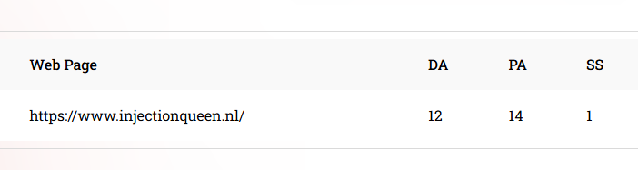
Chapter Five
Current Observation
DA: 12
PA: 14
Spam Score: 1
Action Needed
Need to INCREASE DA and PA

Slide 22
Thank You

